Slide 1

SHRI RAMSWAROOP MEMORIAL UNIVERSITY
PRESENTATION
TOPIC- ARITHMETIC LOGIC UNIT SIMULATOR
SUBMITTED BY –
RINKU VISHWAKARMA
202410101150193
SUBMITTED TO –
Dr. AKHILESH KUMAR GUPTA

Slide 2

INTRODUCTION
Computers work using binary system (0 and 1)
All data and instructions are processed in binary form
Arithmetic operations are used for calculations
Logical operations are used for decision making
These operations are important for computer processing
This project performs basic binary arithmetic and logical operations

Slide 3

OBJECTIVE
To understand binary number system
To perform arithmetic operations like addition and subtraction
To perform logical operations like AND, OR, XOR, NOT
To take input from user and process it
To display correct output
To understand basic working of computer operations

Slide 4

CONCEPTS USED
Binary Number System (0 and 1)
Decimal Number System (0–9)
Arithmetic Operations (Addition, Subtraction)
Logical Operations (AND, OR, XOR, NOT)
Input and Output operations
Basic programming logic

Slide 5
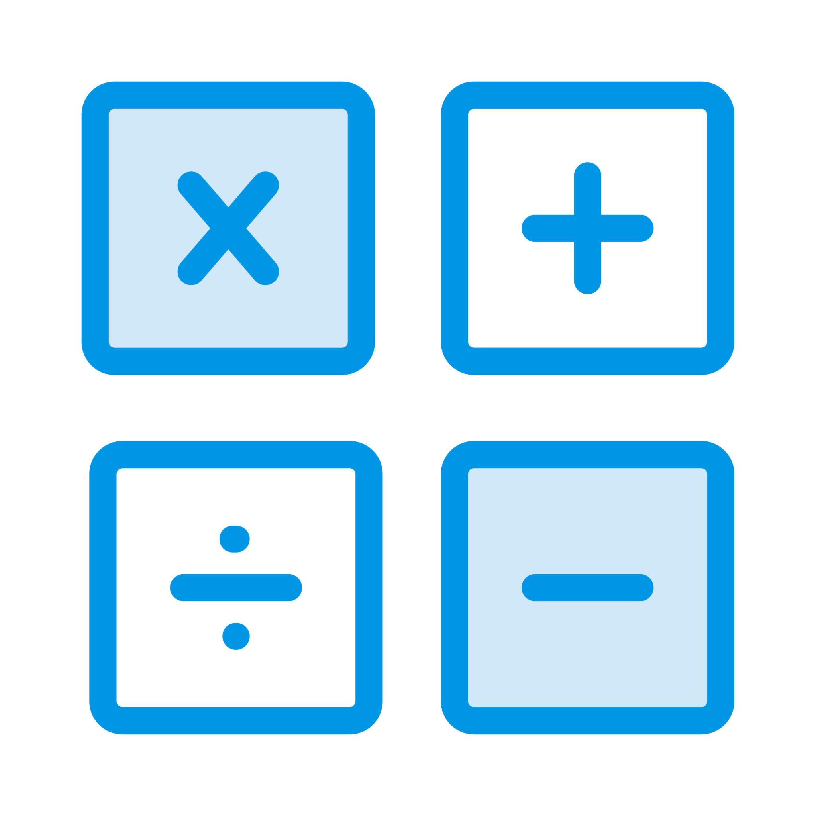
ARITHMETIC OPERATIONS
Arithmetic operations are basic mathematical calculations
Used for performing addition and subtraction
Helps in processing numerical data
Performed inside the CPU
Example: 10 + 5 = 15
Example: 10 - 5 = 5

Slide 6
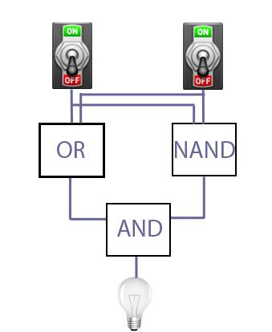
LOGICAL OPERATIONS
Logical operations are used for decision making
AND operation gives 1 only when both inputs are 1
OR operation gives 1 if any one input is 1
XOR operation gives 1 when inputs are different
NOT operation reverses the input value
Used in digital circuits and computer systems

Slide 7
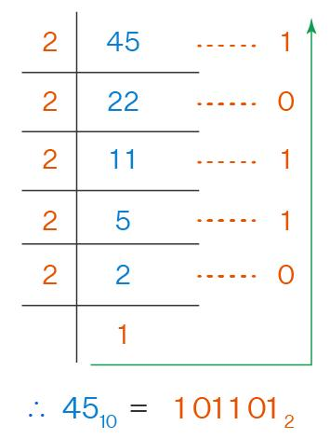
BINARY CONVERSION
Binary conversion is used to change numbers between decimal and binary
Decimal numbers use digits from 0 to 9
Binary numbers use only 0 and 1
Decimal to binary conversion is used for processing in computer
Binary to decimal conversion is used for understanding output
Example: 10 → 1010 and 1010 → 10

Slide 8
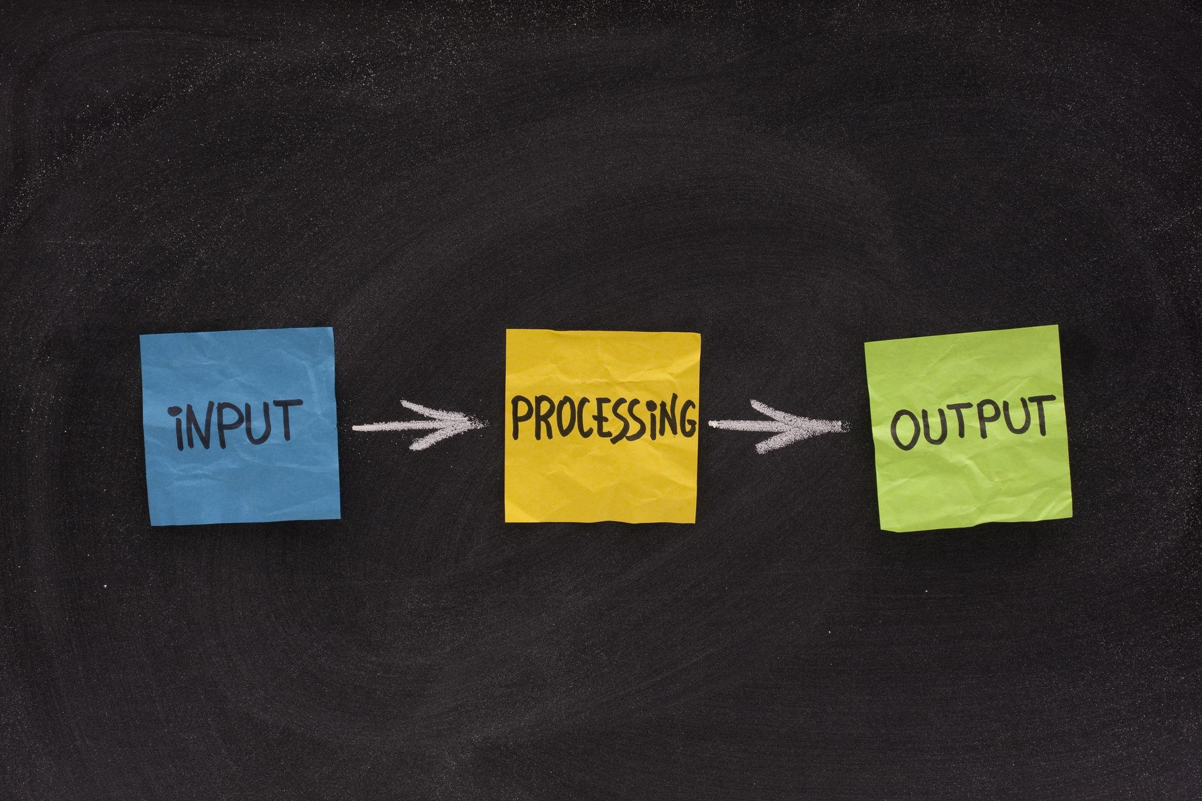
WORKING
The program starts and displays a menu
User enters input values
User selects the required operation
The program processes the input data
Calculation or logic operation is performed
The result is displayed on the screen

Slide 9
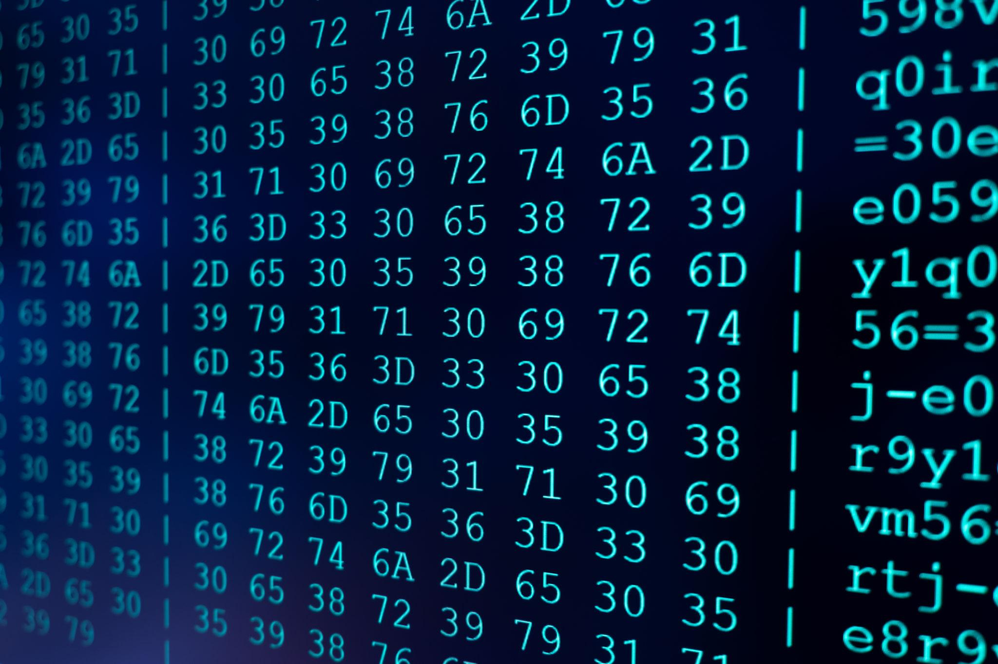
OUTPUT
The program displays result based on selected operation
Shows decimal to binary conversion output
Shows binary to decimal conversion output
Displays arithmetic operation results
Displays logical operation results
Output is clear and easy to understand

Slide 10

CONCLUSION
Learned binary number system
Performed arithmetic operations
Performed logical operations
Understood working of the program
Program executed successfully
Useful for understanding basic computer operations

Slide 11
      THANK YOU

